Slide 1
Making PowerPoint Slides
Avoiding the Pitfalls of Bad Slides

Slide 2
Tips to be Covered
Outlines
Slide Structure
Fonts
Colour
Background
Graphs
Spelling and Grammar
Conclusions
Questions

Slide 3
Outline
Make your 1st or 2nd slide an outline of your presentation
Ex: previous slide
Follow the order of your outline for the rest of the presentation
Only place main points on the outline slide
Ex: Use the titles of each slide as main points

Slide 4
Slide Structure – Good
Use 1-2 slides per minute of your presentation
Write in point form, not complete sentences
Include 4-5 points per slide
Avoid wordiness: use key words and phrases only

Slide 5
Slide Structure - Bad
This page contains too many words for a presentation slide. It is not written in point form, making it difficult both for your audience to read and for you to present each point. Although there are exactly the same number of points on this slide as the previous slide, it looks much more complicated. In short, your audience will spend too much time trying to read this paragraph instead of listening to you.

Slide 6
Slide Structure – Good
Show one point at a time:
Will help audience concentrate on what you are saying
Will prevent audience from reading ahead
Will help you keep your presentation focused

Slide 7
Slide Structure - Bad
Do not use distracting animation
Do not go overboard with the animation
Be consistent with the animation that you use

Slide 8
Fonts - Good
Use at least an 18-point font
Use different size fonts for main points and secondary points
this font is 24-point, the main point font is 28-point, and the title font is 36-point
Use a standard font like Times New Roman or Arial

Slide 9
Fonts - Bad
If you use a small font, your audience won’t be able to read what you have written
CAPITALIZE ONLY WHEN NECESSARY. IT IS DIFFICULT TO READ
Don’t use a complicated font

Slide 10
Colour - Good
Use a colour of font that contrasts sharply with the background
Ex: blue font on white background
Use colour to reinforce the logic of your structure
Ex: light blue title and dark blue text
Use colour to emphasize a point
But only use this occasionally

Slide 11
Colour - Bad
Using a font colour that does not contrast with the background colour is hard to read
Using colour for decoration is distracting and annoying.
Using a different colour for each point is unnecessary
Using a different colour for secondary points is also unnecessary
Trying to be creative can also be bad

Slide 12
Background - Good
Use backgrounds such as this one that are attractive but simple
Use backgrounds which are light
Use the same background consistently throughout your presentation

Slide 13
Background – Bad
Avoid backgrounds that are distracting or difficult to read from
Always be consistent with the background that you use

Slide 14
Graphs - Good
Use graphs rather than just charts and words
Data in graphs is easier to comprehend & retain than is raw data
Trends are easier to visualize in graph form
Always title your graphs

Slide 15
Graphs - Bad

Slide 16
Graphs - Good

Slide 17
Graphs - Bad

Slide 18
Graphs - Bad
Minor gridlines are unnecessary
Font is too small
Colours are illogical
Title is missing
Shading is distracting

Slide 19
Spelling and Grammar
Proof your slides for:
speling mistakes
the use of of repeated words
grammatical errors you might have make
If English is not your first language, please have someone else check your presentation!

Slide 20
Conclusion
Use an effective and strong closing
Your audience is likely to remember your last words
Use a conclusion slide to:
Summarize the main points of your presentation
Suggest future avenues of research

Slide 21
Questions??
End your presentation with a simple question slide to:
Invite your audience to ask questions
Provide a visual aid during question period
Avoid ending a presentation abruptly

Slide 22

AVOID alien sticky men
Alien creature

Slide 23

Use Instead!
Real-life picture

Slide 24

AVOID ambiguity
Confusing, unclear (Latest technology)

Slide 25

Use Instead!
Actual technology (Latest)

Slide 26

AVOID foreign culture
White dominance (irrelevant; unrelatable)

Slide 27

Use Instead!
Locally relevant images

Slide 28
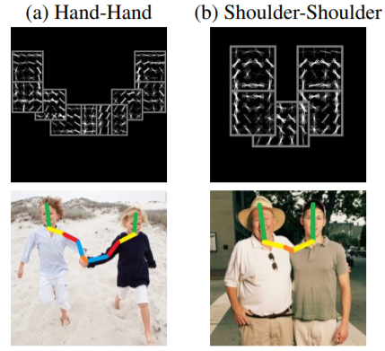
Proxemics: Science of human space

Slide 29
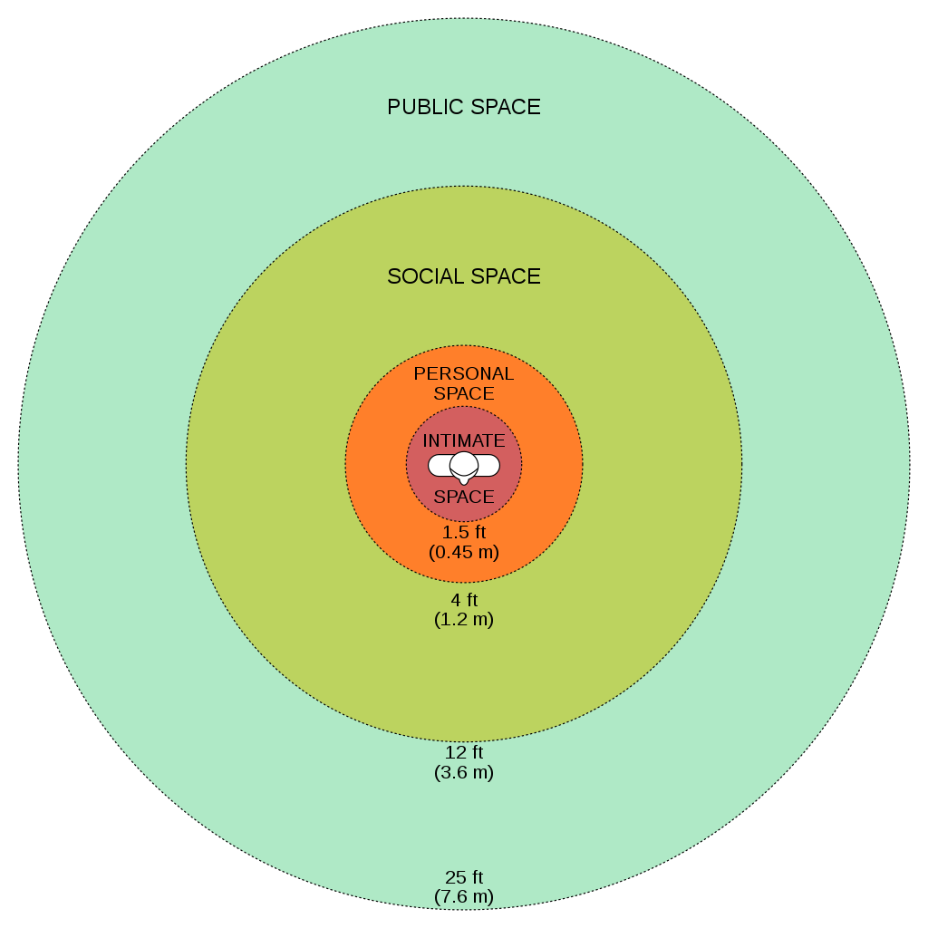
Human distances

Slide 30
The End
Thanks for listening/attention

